Slide 1
Generative Adversarial Nets
Ian J.Goodfellow, Jean Pouget-Abadie, Mehdi Mirza, Bing Xu, David Warde-Farley,
Sherjil Ozair, Aaron Courville, Yoshua Bengio
Presenters
Do Quang Phong - 15021797
Nguyen Tuan Anh - 15020971
Nguyen Hoai Nam - 18020929
Nguyen Minh Dat - 18020288

Slide 2
Outline
Introduction
Generative Adversarial Nets
Advancements
Applications
Conclusion

Slide 3
Introduction

Slide 4
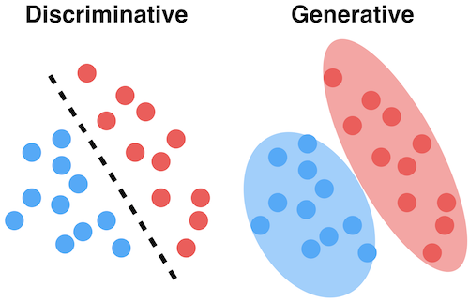
Generative vs Discriminative Models
Given a data sample x, Discriminative model
aims at predicting its label y, hence its model by the posterior distribution P(y|x)
Generative models instead model the distribution P(x) defined over the datapoints x.
P(y | x)
P(x)

Slide 5
Generative Adversarial Networks

Slide 6
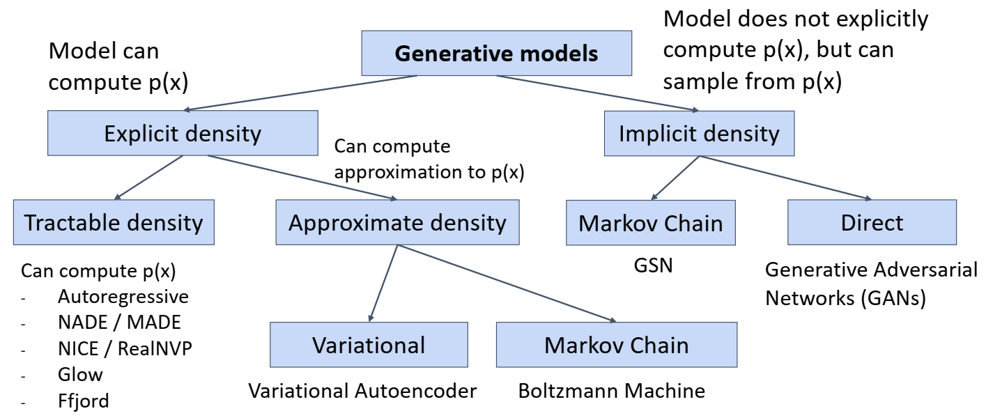
Taxonomy of Generative Models

Slide 7
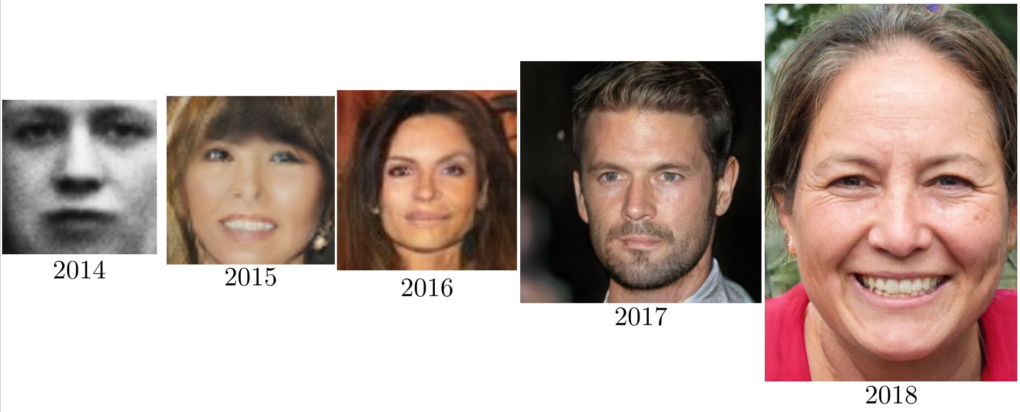
GANs Over Time
2014 - Black - White
2018 - Colored
Photo Realistic
4.5 years of GAN progress on face generation

Slide 8
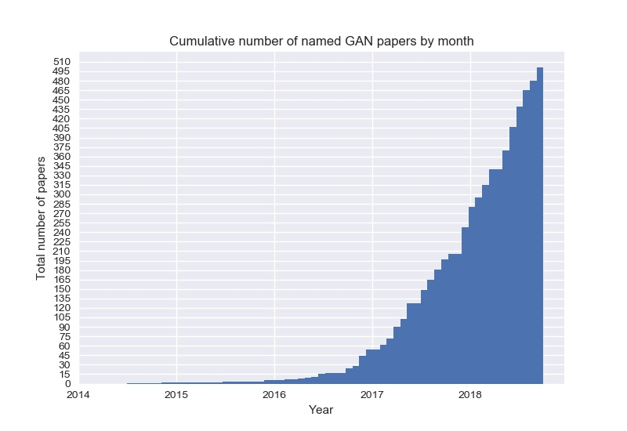
GANs Over Time

Slide 9
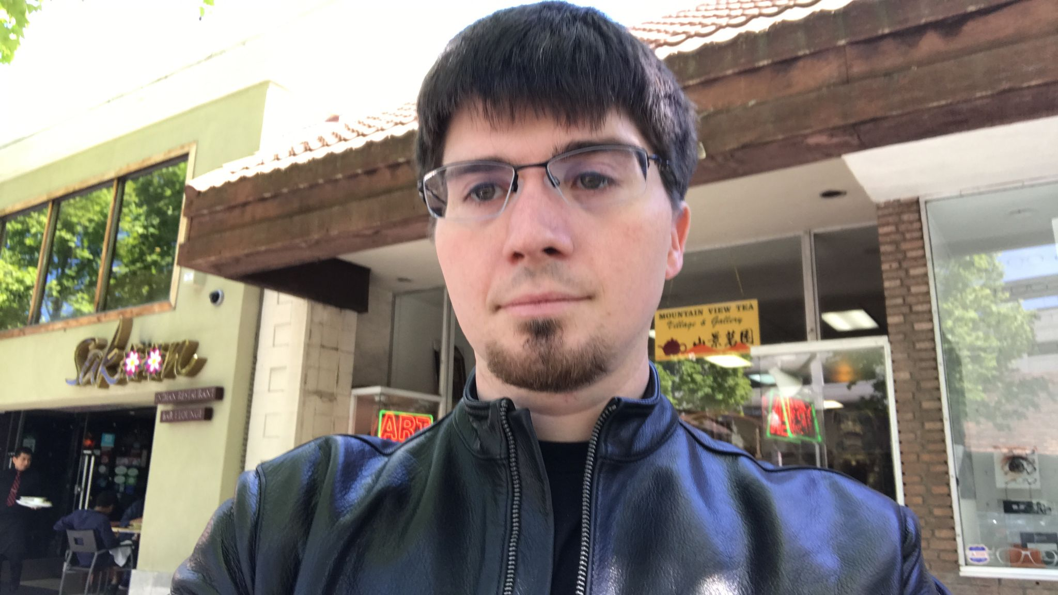

Generative Adversarial Networks (GANs)
An introduction to Generative Adversarial Networks (GANs Goodfellow) accepted in NIPS 2014.
Generator, discriminator.
Some GAN variants
Ian Goodfellow
Generator
Discriminator
Compete

Slide 10
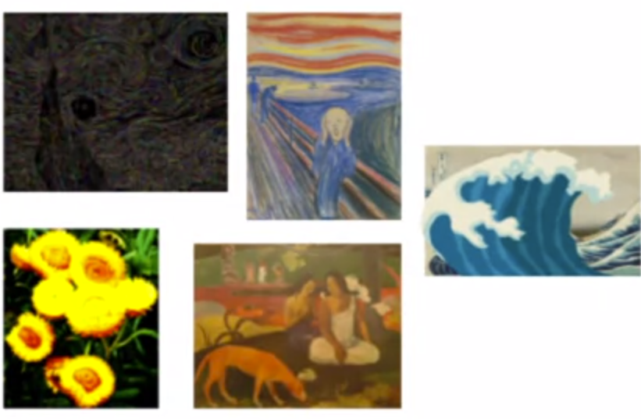
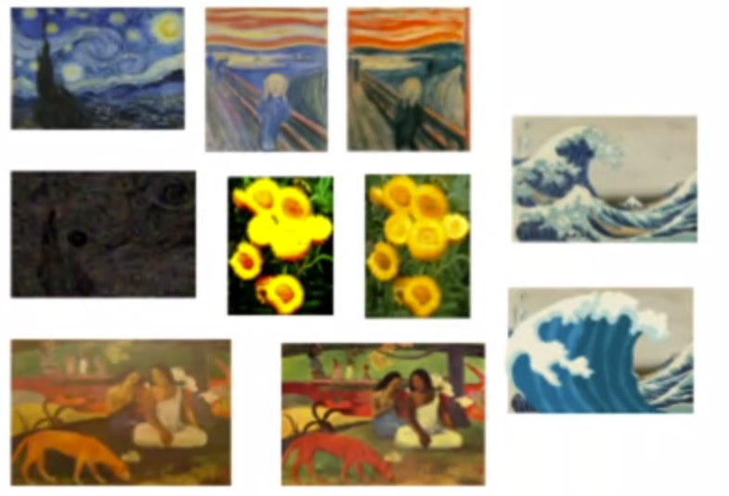
Generative Adversarial Networks (GANs)
Generator
Generator learns to make fakes that look like real
Discriminator
Discriminator learns to distinguish real from fake
Real
Fake
Fake

Slide 11
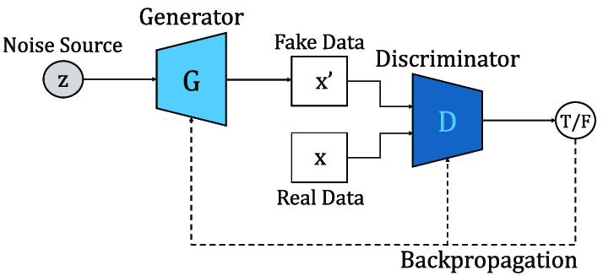
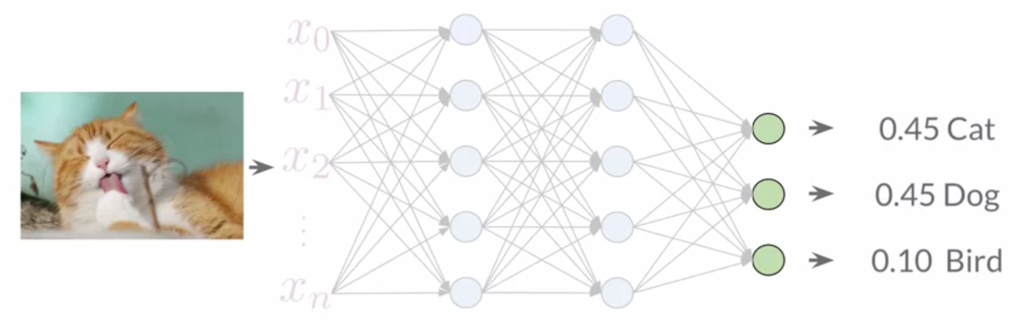
Discriminator
The discriminator is a classification system
It learns the probability of class Y
(real or fake) given by features X.
The probabilities are the feedback
for generator

Slide 12
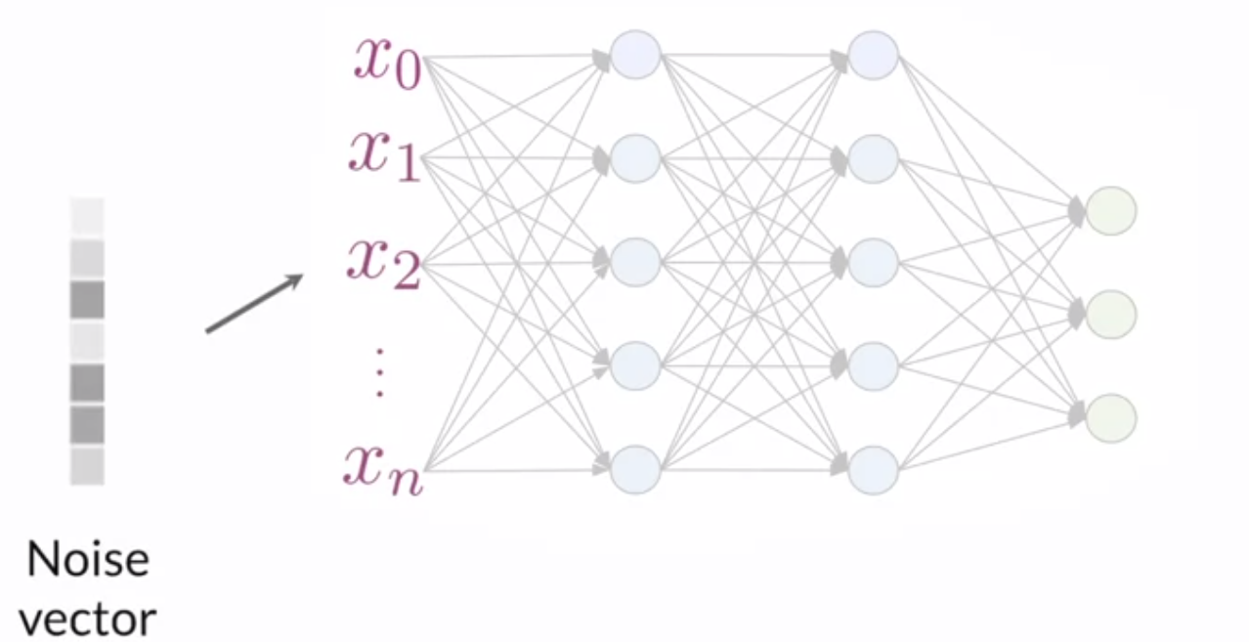
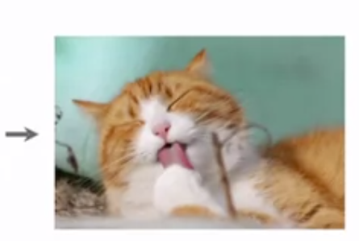
Generator
The generator produces fake data
It learns about the probability of features X
The generator takes input as noise
(random features)

Slide 13
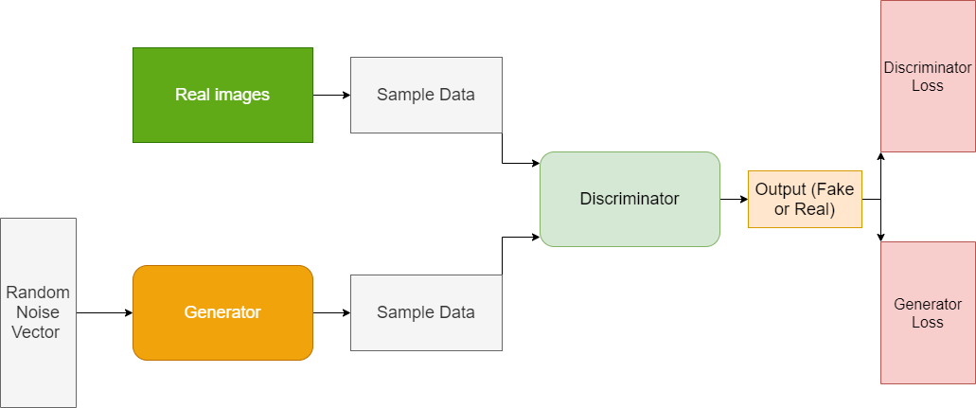
Putting It All Together
The Binary Cross Entropy Loss is used for training model.
GANs training in an alternating fashion
Train Generator & Discriminator together, like a minimax game (adversarial training)
Notes:
Use a fixed, pre-trained discriminator ?
If one model significantly better than the other, it doesn’t help the other learn because the feedback isn’t useful.
Imagine if you were a beginning artist, and you showed your work to an art expert, asking whether your painting looked like a famous piece and all they said was ‘no’.
Because they have a very discerning eye, they know your image is not right, but won’t be able to tell you how close you are.

Slide 14
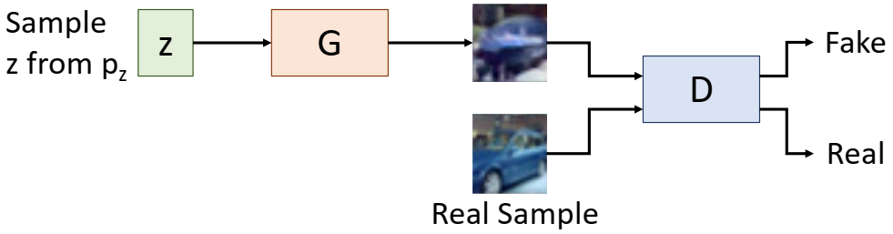
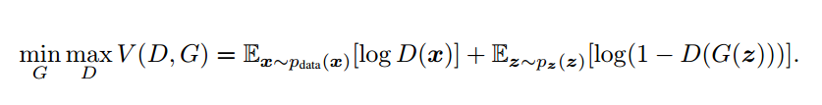
GAN Training Phase
In each iteration, alternately train
Discriminator
Learn a real sample : x
Learn a fake sample : G(z)
Generator
Optimize G to fool D
G(z) -> Real
Object Function

Slide 15
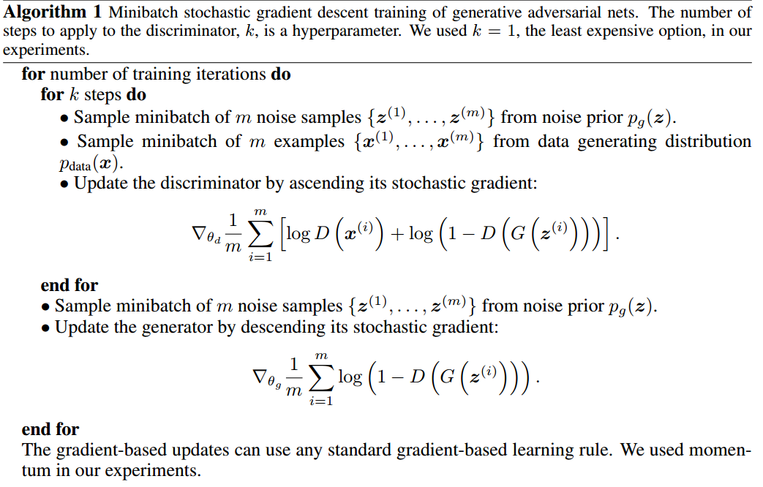

Slide 16
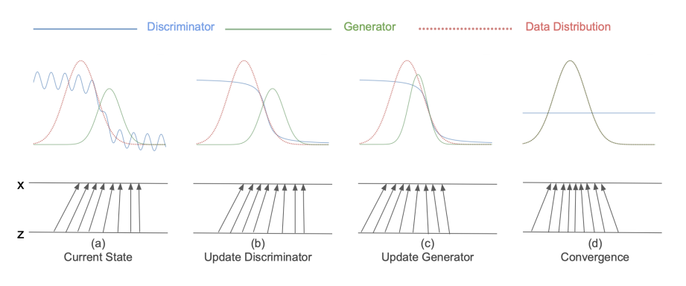
GAN Training Phase
Alternating optimization in GANs

Slide 17
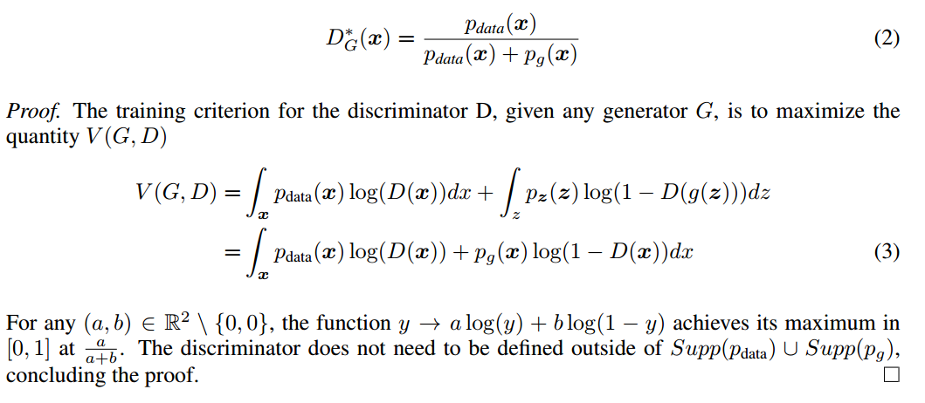
Theoretical Analysis
For a given generator, the optimal discriminator is:

Slide 18
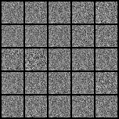
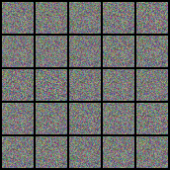
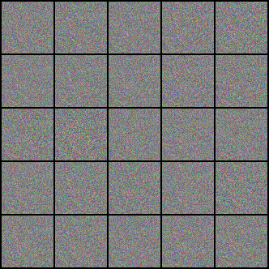
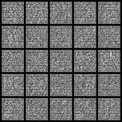
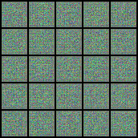
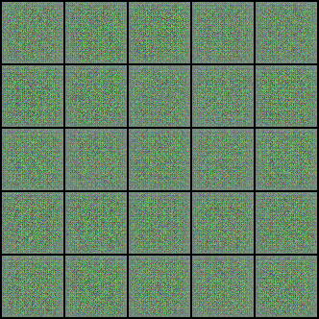
Experiments
MNIST
CIFAR10
CELEBA
Vanilla GAN
DCGAN

Slide 19
Advancements

Slide 20
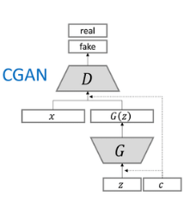
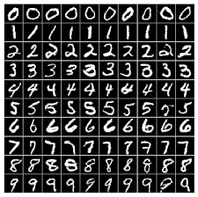
Conditional GAN (cGAN)
Generate image x with known label y
Input noise vector with one-hot presentation of y to
both G & D
Discriminator loss by class
Result on MNIST

Slide 21
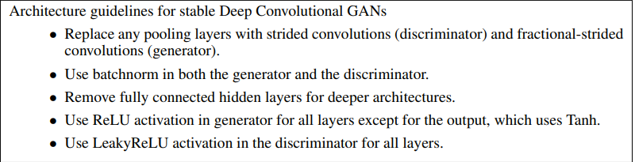
Deep Convolutional GAN (DCGAN)
First working CNN-based GAN
Notably, the generator uses “transposed convolutional layers” also informally called “Deconvolution layers”

Slide 22
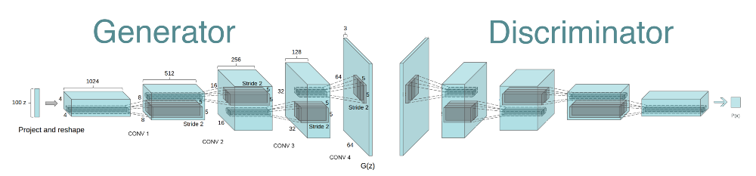
Deep Convolutional GAN (DCGAN)

Slide 23
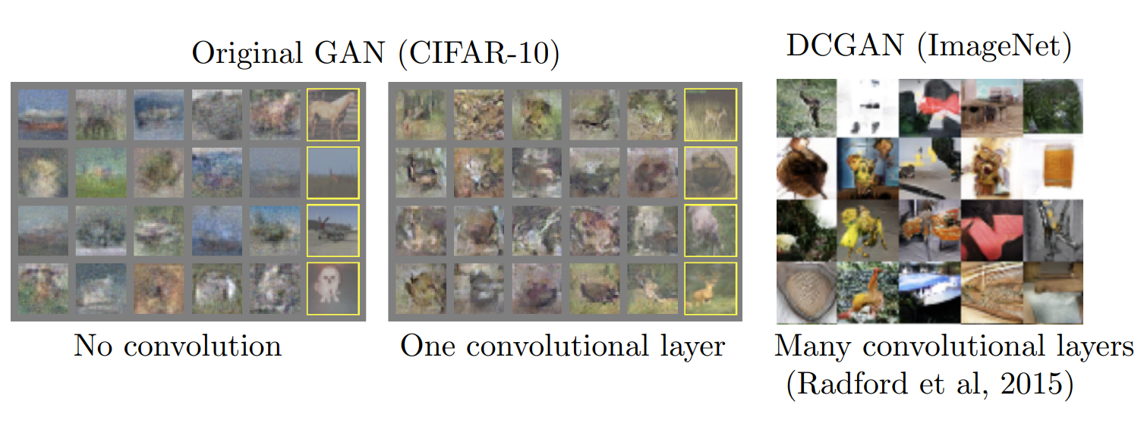
Deep Convolutional GAN (DCGAN)

Slide 24
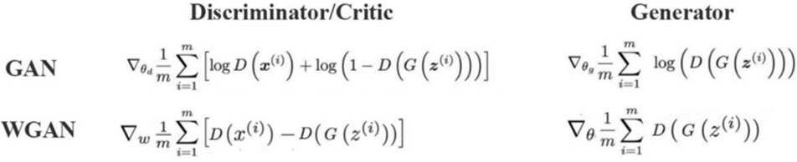
Wasserstein GAN (WGAN)
GAN Issues:
In practice, can optimize the discriminator easier than the generator
If distribution q far away from the ground truth p, the discriminator can saturate early & the generator barely learns anything.
Research has indicated that if your discriminator is too good, then generator training can fail due to vanishing gradients.
Solution : Change loss function => More stable training

Slide 25
Applications

Slide 26
Applications
Huge opportunity to work in applications
Many companies are using GANs for their work
Some applications such as :
Data Augmentation
Image Translation
Adversarial Machine Learning
Face Reenactment

Slide 27
Data Augmentation
Training data issues :
Not enough data to achieve the best performance
Too imbalanced
Supplement data when real data is ...
Too expensive
Too rare
Notes:
Supplement data when real data
Too expensive
Too rare

Slide 28
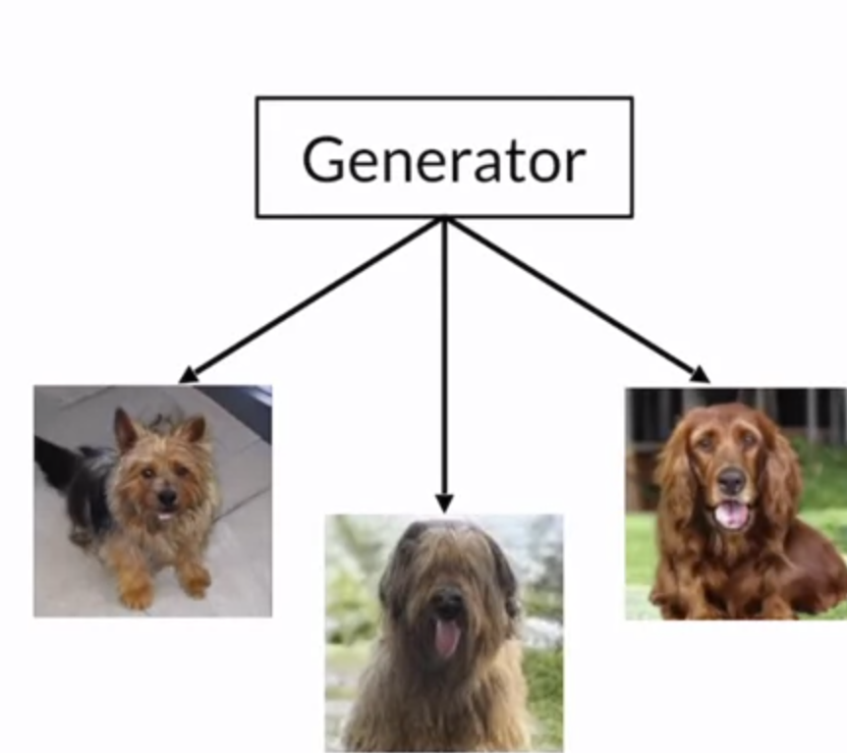
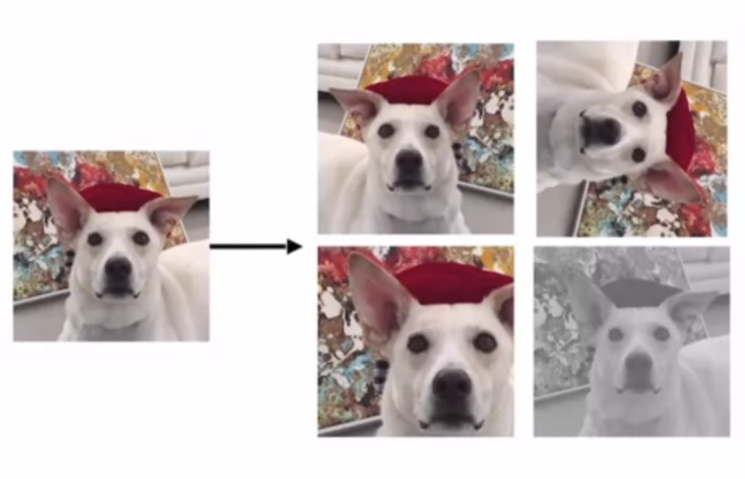
Data Augmentation
Can mix the data augmentation
techniques !

Slide 29
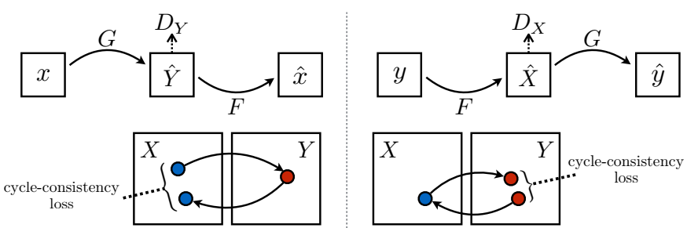
Image Translation
CycleGAN
The most common unpaired training image-to-image translation
Two similar generators
G: x → y (forward)
F: y → x (backward)
Two similar discriminators DX and DY
Cycle-consistency loss

Slide 30

Image Translation
From one domain to another
CycleGAN

Slide 31
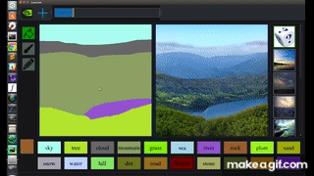
Image Translation
GauGAN
Doodles
Pictures

Slide 32
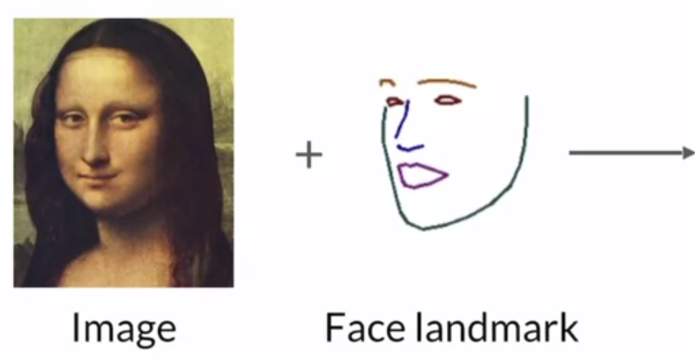
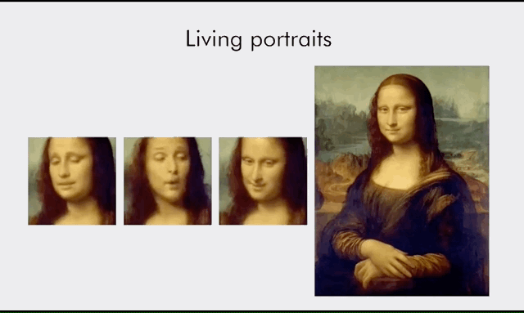
Face Reenactment

Slide 33
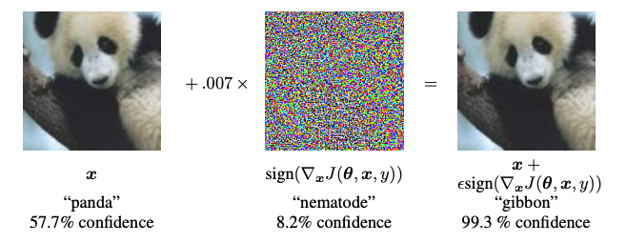
Adversarial Research Areas
Adversarial examples

Slide 34




Companies using GANs
Text
Generation
Next - gen
Photoshop
Data Augmentation
Image Filters

Slide 35
Conclusion
GANs have been successfully applied to several domain and tasks
However, working with GANs can be very challenging in practice
Unstable optimization
Mode collapse
Evaluation
Besides, many cool applications with GANs are using in real life.

Slide 36
Acknowledgement
I. Goodfellow, J. Pouget-Abadie, M. Mirza, B. Xu, D. Warde-Farley, S. Ozair, A. Courville, Y. Bengio, “Generative Adversarial Networks”. In NIPS 2014.
A. Radford, L. Metz, and S. Chintala. “Unsupervised Representation Learning with Deep Convolutional Generative Adversarial Networks”. In ICLR 2016.
M. Arjovsky, S. Chintala, and L. Bottou. “Wasserstein generative adversarial networks”. In ICML 2017
CVPR 2018 Tutorials on GANs
Generative Adversarial Networks (GANs) Specialization
https://github.com/hindupuravinash/the-gan-zoo

Slide 37
Further Reading
https://github.com/goodfeli/adversarial
http://nvidia-research-mingyuliu.com/gaugan/
Improved Training of Wasserstein GANs
https://jonathan-hui.medium.com/gan-wasserstein-gan-wgan-gp-6a1a2aa1b490
https://github.com/junyanz/pytorch-CycleGAN-and-pix2pix
CS236G Generative Adversarial Networks
https://blog.paperspace.com/nvidia-gaugan-introduction/

Slide 38
Thank you for your attention

